Slide 1
Recrafting CSS Industries &
Unbundling Shareholder Value
Varana Capital, LLC
March 2019

Slide 2
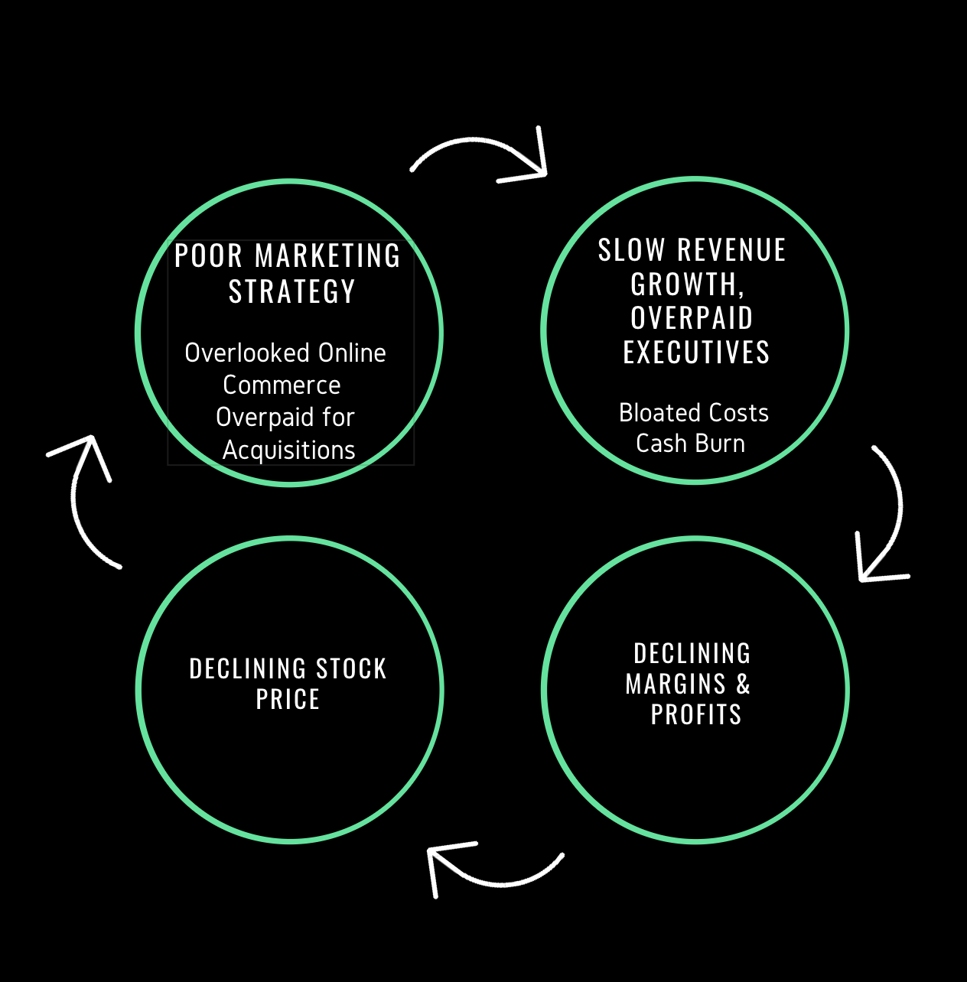
CSS Cycle of Failure
Notes:
Source: SEC
Refer excel sheet –“Income statement” tab
https://www.sec.gov/Archives/edgar/data/20629/000002062915000028/css-3312015x10k.htm
https://www.sec.gov/Archives/edgar/data/20629/000002062916000135/css-3312016x10k.htm
https://www.sec.gov/Archives/edgar/data/20629/000002062917000049/css-3312017x10k.htm#sA06FDCA645ED5656BA9651A4A0A99801
https://www.sec.gov/Archives/edgar/data/20629/000002062918000047/fy201810-k.htm#s45551BB52069596AA3893AF103194EE3
https://www.sec.gov/Archives/edgar/data/20629/000002062919000008/fy2019q310-q.htm

Slide 3
Poor Stock Price Performance
In the last year, the stock price has declined by more than half.
Notes:
Source: Yahoo finance
Refer excel sheet –“Stock price” tab

Slide 4
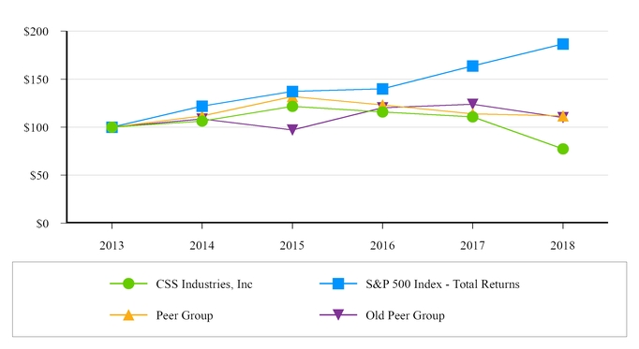
Poor Stock Price Performance
CSS’s stock price has under-performed the S&P 500 Index, the new CSS peer group and the old CSS peer group.
Notes:
Source: SEC
https://www.sec.gov/Archives/edgar/data/20629/000002062918000047/fy201810-k.htm#s45551BB52069596AA3893AF103194EE3

Slide 5
Poor Financial Performance
In spite of revenue growth, in the last 5 years, CSS’s operating performance has steadily declined.
($ in millions) | Years Ended March 31, |  |  |  |  |  | Nine Months Ended December 31,
 | 2014 | 2015 | 2016 | 2017 | 2018 |  | 2017 | 2018
Net sales | 320.5 | 313.0 | 317.0 | 322.4 | 361.9 |  | 280.4 | 310.3
Gross profit | 103.2 | 101.7 | 102.3 | 93.1 | 92.8 |  | 75.9 | 69.8
Operating income (loss) | 28.0 | 26.6 | 26.2 | 9.7 | (45.7) |  | 2.8 | (20.8)
Notes:
https://www.sec.gov/Archives/edgar/data/20629/000002062918000047/fy201810-k.htm#s45551BB52069596AA3893AF103194EE3
https://www.sec.gov/Archives/edgar/data/20629/000002062919000008/fy2019q310-q.htm
Source: SEC
Refer excel sheet –“Income statement” tab

Slide 6
Top Line Challenges: Declining Revenue Growth Rate
The rate of revenue growth is declining rapidly. In Q3 2019, organic sales declined 4% year-over-year, driven primarily by lower craft and gift sales.
($ in millions) | Q4 2018 | Q1 2019 | Q2 2019 | Q3 2019
Net sales | 81.5 | 64.1 | 112.9 | 133.2
Growth % | 39% | 33% | 11% | 2%
Notes:
https://www.sec.gov/Archives/edgar/data/20629/000002062918000047/fy201810-k.htm#s45551BB52069596AA3893AF103194EE3
https://www.sec.gov/Archives/edgar/data/20629/000002062919000008/fy2019q310-q.htm
Source: SEC
Refer excel sheet –“Income statement” tab

Slide 7
Top Line Challenges : Core Segments are Declining
In the last few years, CSS’s two major segments have declined rapidly
Notes:
Source: SEC
Refer excel sheet –“Segment-Customer” tab
https://www.sec.gov/Archives/edgar/data/20629/000002062915000028/css-3312015x10k.htm
https://www.sec.gov/Archives/edgar/data/20629/000002062916000135/css-3312016x10k.htm
https://www.sec.gov/Archives/edgar/data/20629/000002062917000049/css-3312017x10k.htm#sA06FDCA645ED5656BA9651A4A0A99801
https://www.sec.gov/Archives/edgar/data/20629/000002062918000047/fy201810-k.htm#s45551BB52069596AA3893AF103194EE3
https://www.sec.gov/Archives/edgar/data/20629/000002062919000008/fy2019q310-q.htm

Slide 8
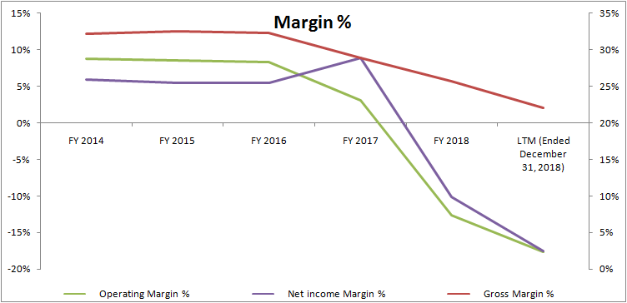
Declining Profitability
In the last 5 years, company’s profit margins have declined.
Notes:
Source: SEC
Refer excel sheet –“Charts” tab
https://www.sec.gov/Archives/edgar/data/20629/000002062918000047/fy201810-k.htm#s45551BB52069596AA3893AF103194EE3
https://www.sec.gov/Archives/edgar/data/20629/000002062919000008/fy2019q310-q.htm

Slide 9
Declining Profitability
In the last few years, operating income and Adjusted EBITDA has declined rapidly.
Notes:
Source: SEC
Refer excel sheet –““Income statement” and “charts”” tab
https://www.sec.gov/Archives/edgar/data/20629/000002062918000042/fy2018exhibit991.htm
https://www.sec.gov/Archives/edgar/data/20629/000002062919000009/fy2019q3earningsreleaseexh.htm
https://www.sec.gov/Archives/edgar/data/20629/000002062918000047/fy201810-k.htm#s45551BB52069596AA3893AF103194EE3
https://www.sec.gov/Archives/edgar/data/20629/000002062919000008/fy2019q310-q.htm

Slide 10
Poor Capital Allocation
In the last few years, ROE and ROIC has declined rapidly.
Notes:
Source: SEC
Refer excel sheet –“Income statement” tab
https://www.sec.gov/Archives/edgar/data/20629/000002062915000028/css-3312015x10k.htm
https://www.sec.gov/Archives/edgar/data/20629/000002062916000135/css-3312016x10k.htm
https://www.sec.gov/Archives/edgar/data/20629/000002062917000049/css-3312017x10k.htm#sA06FDCA645ED5656BA9651A4A0A99801
https://www.sec.gov/Archives/edgar/data/20629/000002062918000047/fy201810-k.htm#s45551BB52069596AA3893AF103194EE3
https://www.sec.gov/Archives/edgar/data/20629/000002062919000008/fy2019q310-q.htm

Slide 11
Bloated Cost Structure
In the last 3.9 years, SG&A cost increased by a whopping 57% or $43 million.
During the same period, SG&A growth outpaced revenue growth by more than 100%.
Given the fact that CSS’s gross margin is under pressure, the rising SG&A is affecting the company’s bottom line.
 | FY 2015 | FY 2016 | FY 2017 | FY 2018 | LTM Dec ‘18 |  | 9M Dec 2017 | 9M Dec 2018
Net sales | 313.0 | 317.0 | 322.4 | 361.9 | 391.8 |  | 280.4 | 310.3
SG&A | 75.1 | 76.0 | 83.4 | 105.2 | 118.1 |  | 44.0 | 57.3
SG&A as a % of revenue | 24% | 24% | 26% | 29% | 30% |  | 29% | 32%
Notes:
Source: SEC
Refer excel sheet –“Income statement” tab
https://www.sec.gov/Archives/edgar/data/20629/000002062915000028/css-3312015x10k.htm
https://www.sec.gov/Archives/edgar/data/20629/000002062916000135/css-3312016x10k.htm
https://www.sec.gov/Archives/edgar/data/20629/000002062917000049/css-3312017x10k.htm#sA06FDCA645ED5656BA9651A4A0A99801
https://www.sec.gov/Archives/edgar/data/20629/000002062918000047/fy201810-k.htm#s45551BB52069596AA3893AF103194EE3
https://www.sec.gov/Archives/edgar/data/20629/000002062919000008/fy2019q310-q.htm

Slide 12
Significant Cash Burn
In the last 4.9 years, CSS’s cash balance has been reduced by a staggering 82%.
If the current burn rate continues, the company will be forced to raise debt or equity. Both of these scenarios could affect the already depressed stock price.
Notes:
Source: SEC
Refer excel sheet –“Income statement” tab
https://www.sec.gov/Archives/edgar/data/20629/000002062915000028/css-3312015x10k.htm
https://www.sec.gov/Archives/edgar/data/20629/000002062916000135/css-3312016x10k.htm
https://www.sec.gov/Archives/edgar/data/20629/000002062917000049/css-3312017x10k.htm#sA06FDCA645ED5656BA9651A4A0A99801
https://www.sec.gov/Archives/edgar/data/20629/000002062918000047/fy201810-k.htm#s45551BB52069596AA3893AF103194EE3
https://www.sec.gov/Archives/edgar/data/20629/000002062919000008/fy2019q310-q.htm

Slide 13
Poor Capital Allocation

Slide 14
Overpaying for Acquisitions
Under the current CEO’s tenure, 7 out of 12 acquisitions’ goodwill are impaired.
Goodwill impairment for the recent acquisitions are happening at a much faster pace.
In November 2017, CSS acquired Simplicity for ~$70 million. In Fiscal 2018, CSS impaired $9.6 million of goodwill.
In June 2018, CSS acquired Fitlosophy for $4.1 million. In the subsequent quarter, CSS recorded impairment of goodwill towards this acquisition.
Date | Target company name | Total Value ($, mm) | Goodwill | Impairment
Jun-18 | Fitlosophy | 4.1 | 1.39 | Sep 2018 quarter
Nov-17 | Simplicity Creative Group | 69.6 | 9.6 | Fiscal 2018
Feb-16 | Blumenthal Lansing Company | 19.6 | 4.1 | Fiscal 2018
Feb-15 | Hollywood Ribbon Industries | 12.9 | 0.7 | Fiscal 2018
May-14 | Carson & Gebel Ribbon Co. | 5.2 | 0.6 | Fiscal 2018
Aug-08 | Hampshire Paper Corp. | 9.7 | 0.9 | Fiscal 2018
Dec-07 | C.R. Gibson | 73.8 | 17.4 | Fiscal 2018
Notes:
Source: SEC

Slide 15
Poor Business Strategy

Slide 16
Lack of Online Strategy
If there is one mistake that has affected CSS considerably, it is the lack of an online presence.
E-commerce websites changed the way Americans shop. The US gift industry is no exception.
Walmart, the retail giant, started selling online in 2000 when it recognized the growing shift from retail to online.
In spite of the shift in the industry dynamics, CSS continued to sell its product through mass-market retailers and ignored the online channel. In fact, in Q1 2019 Earnings Conference Call (source), the CEO acknowledged that CSS was expected to generate less than 5% of its revenue from online by the end of fiscal 2019 fiscal. The incumbent Directors overlooked the importance of reaching out directly to customers via online stores like Amazon.com.
In fact, until the fiscal 2017 10-K, there is no mention of online sales.
Notes:
Source: SEC Form 10-K
https://www.digitalcommerce360.com/2018/09/20/holiday-e-commerce-sales-expected-to-increase-15-5-in-2018/
https://www.ibisworld.com/industry-trends/market-research-reports/retail-trade/miscellaneous-store-retailers/gift-shops-card-stores.html

Slide 17
Lack of Online Strategy
According to a March 2018 Internet Retailer and Bizrate Insights survey, more consumers are buying gifts online each year. For instance, 76% of US shoppers said they purchased at least 25% of their gifts online in the last holiday shopping season (November to December).
According to an IBISWorld report published in November 2018, over the past five years, the number of Gift Shops and Card Stores in the US has declined by -1.0% to reach revenue of $17bn in 2018.
The Board narrow-mindedly focused on acquisition for their revenue growth and ignored the industry’s changing dynamics. In the last seven earnings calls that Mr. Munyan has participated, executives and analysts on the calls have said the word "acquisition” 94 times, nearly five times as often as the word “online.”
Notes:
Source: SEC Form 10-K
https://www.digitalcommerce360.com/2018/09/20/holiday-e-commerce-sales-expected-to-increase-15-5-in-2018/
https://www.ibisworld.com/industry-trends/market-research-reports/retail-trade/miscellaneous-store-retailers/gift-shops-card-stores.html

Slide 18
No meaningful brand presence on Amazon
In spite of being in the industry for more than three decades, CSS has no meaningful brand presence on Amazon.
None of CSS’s products is in the top 100 best selling products for Arts, Crafts & Sewing or Greeting Cards.
CSS’s highest ranking ribbon product (Berwick ribbon) is in #12th position.
Even in the small sub-set of products like Latch Hook, Cross Stitch, Embroidery, Needlepoint, Needle-felting and Buttons, CSS’s product is not in the top 5 best selling products list.
Why should CSS increase sales on Amazon?
As of July 2018, Amazon's share of the US e-commerce market was 49%. Not selling products through Amazon is a huge mistake.
Notes:
Refer excel sheet “best seller in amazon" tab
https://techcrunch.com/2018/07/13/amazons-share-of-the-us-e-commerce-market-is-now-49-or-5-of-all-retail-spend/

Slide 19
No meaningful brand presence on Amazon
CSS Industries does not have a Amazon Stores Page
Amazon Stores allow brand owners to design and create multipage stores to showcase their brands and products on Amazon. It’s basically like creating your own ecommerce website on Amazon.
Even though this feature launched in 2012, CSS Industries is yet to embrace this option.
This is the Amazon page of LaRibbons, a competitor for CSS Industries on Amazon
Notes:
Refer excel sheet “best seller in amazon" tab
https://techcrunch.com/2018/07/13/amazons-share-of-the-us-e-commerce-market-is-now-49-or-5-of-all-retail-spend/

Slide 20
Confusing Brand Name Competition
CSS owns a number of brands that appear to be competing for customers. CSS should consolidate to one or two brands
 | Instagram | Facebook | Pinterest |  | Website | Twitter
CSS Industries |  | 1,400 followers |  |  | cssindustries.com
Lion Ribbon | 1,800 Followers | 5,300 followers | 22,000 monthly views |  | lionribbon.com | 366 Followers
Offray Ribbon | 1,200 Followers | 5,500 followers | 35,000 monthly views |  | offray.com
Berwick Offray |  | 1,300 followers |  |  | berwickoffraywholesale.com
Hampshire Paper |  | 188 followers
Berwick Offray Ribbon Outlet |  | 2,700 followers

Slide 21
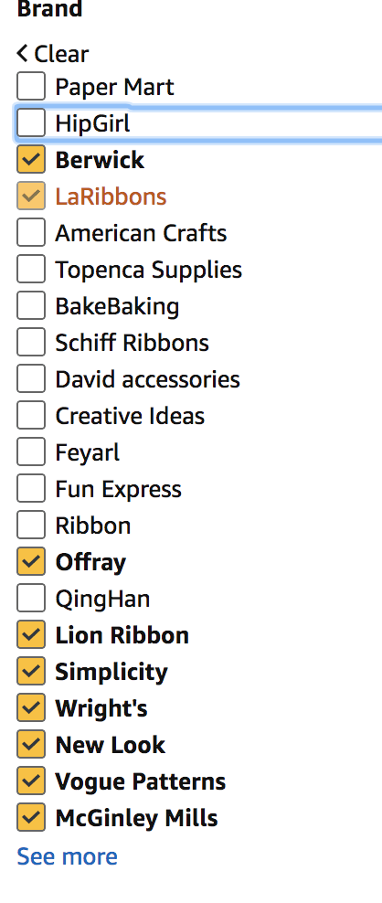
Streamline Brand Names
Amazon is selling at least eight CSS brands under separate online brands and amazon stores

Slide 22
Huge Compensation

Slide 23
In the last decade, the Board richly rewarded the CEO
The CEO enjoys huge and increasing compensation.
1. Salary hike
CEO received base salary hikes in 11 out of 12 years.
2. Discretionary bonus
In 12 years, the Board awarded discretionary bonuses to the CEO for 8 years.
3. Performance bonus
Year | Salary ($) | Salary hike %
2018 | 654,491 | 2.0%
2017 | 641,658 | 2.5%
2016 | 626,008 | 3.0%
2015 | 607,775 | 3.0%
2014 | 590,073 | 3.0%
2013 | 572,886 | 3.0%
2012 | 556,200 | 3.0%
2011 | 540,000 | 2.9%
2010 | 525,000 | 0.0%
2009 | 525,000 | 9.4%
2008 | 480,000 | 6.7%
DOJ | 450,000
The Board rewarded the CEO with performance awards during 2013 - 2016, during which the share price remained stagnant.
Year | Bonus
2018 | $186,530
2017 | —
2016 | $81,380
2015 | $72,933
2014 | $59,007
2013 | $93,761
2012 | $96,223
2011 | $137,760
2010 | —
2009 | —
2008 | $297,973
Source: Company filings
Notes:
Source: SEC
Refer excel sheet "CEO Compensation" tab

Slide 24
In the last decade, the Board richly rewarded the CEO
Fringe benefits
The pampering did not stop at pay hikes and discretionary bonuses, Mr. Munyan is also showered with various “other benefits.”
In the past three years, CSS spent roughly $28,000 every year towards “other benefits”.
X Personal use of company car
X Car allowance
X Company-paid parking fees
X Reimbursement of medical and prescription costs not covered by insurance
X Supplemental life insurance policy premiums
X Matching contributions under tax-qualified 401(k) and profit sharing plans
X Business club dues
X Health club dues
X Professional association dues
Source: Company filings
Notes:
Source: SEC
Refer excel sheet "CEO Compensation" tab

Slide 25
Absurd practices by the Human Resources Committee to determine CEO’s compensation
Question #1
CSS claims that “Mr. Munyan did not make recommendations as to his own compensation.”
If the above statement is true, why does Mr. Munyan provide his own self-evaluation to the Human Resources committee which determines the compensation?
On an annual basis, and otherwise as deemed appropriate by Mr. Munyan or as requested by the Human Resources Committee, Mr. Munyan provides the Human Resources Committee with his evaluation of the performance of our named executives, including Mr. Munyan’s own self-evaluation.
Question #2
For a CEO who has led for more than ___ years, what is the relevance of the below criteria?
- Experience relative to the needs of CSS.
Tenure in current position
Salary history
Expected future contributions to the company
In determining Mr. Munyan’s base salary for fiscal 2017, the Human Resources Committee considered both his and CSS’ performance during fiscal 2016, his skill set and experience relative to the needs of CSS, his tenure in his current position, his salary history, his expected future contributions to CSS, and the Company’s overall budget for fiscal 2017 salary increases.
Notes:
Source: SEC filing

Slide 26
Picked Wrong Peer Groups for Executive Compensation
Company Name | FY 2017 / FY 2018 - Base salary ($, mm) | M.Cap ($, mm) | EV ($, mm)
Neenah Paper, Inc. | 0.830 | 1,210 | 1,570
Knoll, Inc | 1.009 | 955 | 1,430
Lannett Company, Inc. | 0.735 | 302 | 966
National Presto Industries, Inc. | 0.575 | 772 | 563
Ennis, Inc. | 0.915 | 548 | 503
Lifetime Brands, Inc. | 0.990 | 195 | 492
Libbey Inc | 0.770 | 71 | 452
Hooker Furniture Corporation | 0.415 | 326 | 341
Destination Maternity Corporation | 0.350 | 27 | 76
CSS Industries | 0.654 | 58 | 99
Most of the peer group companies reported in the proxy statement are at least two times larger than CSS. Notably, two companies are roughly 10 times bigger than CSS Industries.
How can the Human Resources Committee use this data to set the compensation of the CEO?
Notes:
Source: SEC
Refer excel sheet "Peer group Vs CEO Base salary" tab

Slide 27
Rebecca Matthias: Overpaid Chairman & Web Of Connections
Ms. Matthias’s Board fee is a whopping $0.483 million in FY 2018. We believe this fee exceeds that of a full time senior executive of CSS.
Why does the Board award huge compensation to Ms. Matthias?
Year | Fees earned or paid in cash ($) | Stock awards ($) | Options awards ($) | Total Compensation
2018 | 214,500 | 268,200 | 0 | 482,700
2017 | 216,185 | 265,400 | 0 | 481,585
2016 | 177,683 | 272,700 | 25,520 | 475,903
2015 | 128,250 | 0 | 34,440 | 162,690
2014 | 58,750 | 0 | 47,080 | 105,830
2013 | 61,173 | 0 | 29,880 | 91,053
2012 | 62,500 | 0 | 27,132 | 89,632
2011 | 52,000 | 0 | 26,880 | 78,880
2010 | 47,000 | 0 | 25,798 | 72,798
2009 | 45,000 | 0 | 52,221 | 97,221
2008 | 40,000 | 0 | 52,438 | 92,438
Notes:
Source: SEC
Refer excel sheet “Compensation" tab

Slide 28
Rebecca Matthias: Overpaid chairman & web of connections
Ms. Matthias founded Mothers Work and served as President from 1982 to 2010.
During her tenure at Mothers Work, Mr. Hitchner served as a Director and the law firm where he worked as a Partner provided legal services to CSS. In addition, Mr. Miller also served as a Director of Mothers Work from 1992 to 1999.
Elam M. Hitchner
From April 1987 to May 1992, Mr. Hitchner was a Partner of the law firm of Braemer Abelson & Hitchner, which provided legal services to Mothers Work.
Since May 1992, Mr. Hitchner has been a Partner of the law firm of Pepper Hamilton LLP, which provided legal services to Mothers Work.
Director at CSS since 2013
William L. Rulon-Miller
William L. Rulon-Miller became a Director of Mothers Work in 1992.
Director at CSS since 2016
Rebecca C. Matthias
Ms. Matthias is a Director since 2003.
Ms. Matthias founded Mothers Work (now Destination Maternity) in 1982 and served as President from inception until 2010 and as a Director from inception until February 2011.
Notes:
Source: SEC
Source: DEF 14 filed by Mothers Work, January 1999.

Slide 29
Ms. Matthias’s prior connection help hear earn huge Board fees ??
The Human Resources Committee reviews and makes recommendations to the Board regarding the compensation of Board Chair.
Mr. Hitchner, Chairman of Human Resources committee, has previously provided legal services to Mothers Work, which was founded by Ms. Matthias.
Given the fact that the Ms. Matthias earns huge compensation, we believe Mr. Hitchner’s prior business relationship with Ms. Matthias is affecting his judgment.
Notes:
Source: SEC
Refer excel sheet “Compensation" tab

Slide 30
Pepper Hamilton
Pepper Hamilton provides legal services to CSS Industries. Current Director and current executive has prior relationship to Pepper Hamilton.
Elam M. Hitchner, III, current Director, is a retired former Partner of the law firm Pepper Hamilton, LLP. He was a Partner of Pepper Hamilton from May 1992 to June 1999, and returned to the firm in January 2001 as a Partner and subsequently as “of counsel” through 2004. From 2005 until December 2015, he provided consulting services to Pepper Hamilton.
Lori White: The current VP (Licensing & Intellectual Property) and former Corporate Counsel is a former attorney of Pepper Hamilton, LLP.
Notes:
https://www.sec.gov/Archives/edgar/data/20629/000002062918000050/cssproxy2018.htm (page 5 and 6)

Slide 31
Low Director Ownership
4 out of 7 Directors own fewer than 5,000 shares.
Name | Director Since | Tenure | Current Position(s) | Ownership (excluding option) | Total Shares
Rebecca C. Matthias | 2003 | 15 | Non-executive Chair of the Board since July 2015 | 1.04% | 94,821
Christopher J. Munyan | 2006 | 12 | President and CEO since July 2006 | 0.88% | 80,274
Robert E. Chappell | Sep-2012 | 6 | Director | 0.13% | 11,702
Elam M. Hitchner, III | May-2013 | 5.6 | Director | 0.05% | 4,702
William Rulon-Miller | Mar-2016 | 2.8 | Director | 0.05% | 4,702
Harry J. Mullany, III | Feb-2017 | 1.9 | Director | 0.03% | 2,864
Stephen P. Crane | Mar-2018 | 9 months | Director | 0.00% | —
Notes:
Source: SEC
Refer excel sheet "Insider ownership" tab

Slide 32
ISS
As per Institutional Shareholder Services (ISS), a Director’s tenure of more than 9 years is considered excessive. CSS Industries has two long standing Directors, Matthias and Munyan, who have served on the Board for more than a decade.
At the 2015 AGM, ISS, a proxy advisory company, recommended that shareholders withhold votes from three Board candidates - Rebecca Matthias, Scott Beaumont and Lee Hitchner.
Name | Age | Director Since | Tenure | Current Position(s)
Rebecca C. Matthias | 65 | 2003 | 16 years | Non-executive Chair of the Board since July 2015
Christopher J. Munyan | 53 | 2006 | 13 years | President and CEO since July 2006
Notes:
https://www.sec.gov/Archives/edgar/data/20629/000002062918000050/cssproxy2018.htm (page 5 and 6)
Refer excel sheet "Director" tab

Slide 33
Other Indicators

Slide 34
Next Steps

Slide 35
Possible next steps for CSS Industries
Mentor senior management on aggressively pursuing an online strategy.
Undertake an in-depth review of CSS’s business lines.
Improve corporate governance, including redeeming the rights issued under the poison pill plan.
Adopt measures designed to optimize cost structure and maximize operating efficiencies.
Ensure that compensation for directors and officers is tied to CSS earnings and stock price

Slide 36
Possible next steps for CSS Industries
Mentor senior management on aggressively pursuing an online strategy.
Undertake an in-depth review of CSS’s business lines.
Improve corporate governance, including redeeming the rights issued under the poison pill plan.
Adopt measures designed to optimize cost structure and maximize operating efficiencies.
Ensure that compensation for directors and officers is tied to CSS earnings and stock price

Slide 37
Our Nominees

Slide 38
Robert “Bob” Kelman
Robert “Bob” Kelman is currently the CEO and JV Partner in FE Trading Group. FE Trading Group LLC is a scrap trading and brokerage company based in NY, trading ferrous scrap between producers and steel mill consumers throughout North America.
Bob has worked in the scrap metal recycling industry for over three decades and in his current role since May of 2017. Today he is considered one of the top scrap metal/recycling executives in the world. Throughout Bob’s career he has worked in every aspect of the business. Starting right out of college in operations, he moved into commercial and then management positions, from Superintendent to President and COO.Bob’s intellect, integrity, honesty and creativity are traits well known to his former Sims Metal Management Board, CEO and peers. He has a reputation for being a thoughtful problem solver; tough but fair, and as has a record of success in all of his prior endeavors.
Prior to his current position as CEO and JV partner in Fe Trading Group, Bob lived in London where he worked as Managing Director of the Sims MM European Scrap business. It was in this role that Bob gained a valuable global perspective on the Scrap Metal business. Prior to London Bob was based in NY where he was Sims MM President of North America Metals. As President Bob was the chief architect and manager of CSS’s long-term contract with New York City to recycle curbside post-consumer metals, plastic and glass – returning curbside recycling to the city. He was the key executive responsible for integrating the Sims and Metal Management executive leadership teams in 2008/2009 while navigating the aftermath of the global financial crisis. Prior to the 2005 merger of Hugo Neu Corporation and Sims Group, Bob was Senior Vice President and General Manager of Hugo Neu Schnitzer East. After Sept 11, 2001 Bob worked directly with the City of New York to safely process and recycle over 286,000 tons of steel and metal recovered from Ground Zero.
Bob’s career has allowed him to travel the world and to move from the suburbs of New Jersey to Los Angeles, New York and London. He graduated from SUNY Maritime College in 1986 with a Bachelor of Science Degree in Marine Engineering and Naval Architecture. Bob has received a number of recognition awards and strong endorsements for his commitment to sustainable development and protection of the environment from the NY League of Conservation Voters and The Natural Resource Defense Council. Bob presently lives in NYC with his wife Linda and their youngest daughter Grace. Linda and Bob have two other adult daughters living in Washington, DC and Brooklyn, NY.

Slide 39
Jerry Bailey
Jerry Bailey is an independent director on the Rabobank North America Board of Directors and Utrecht-America Holdings Board of Directors. Mr. Bailey has no former affiliation with Rabobank. He is the chairman of the Rabobank North America Board Audit Committee and Utrecht-America Holdings Board Audit Committee.
Mr. Bailey brings four decades of experience in positions across the financial services industry. He served as Chief Financial Officer-Institutional Clients Group at Citigroup Inc. from August 2011 until his retirement in October 2014. Mr. Bailey served in 2008 and 2009 as Chief Financial Officer and Chief Information Officer of Equiniti Ltd., a UK-based provider of administrative, processing and payment solutions. Mr. Bailey has also served as Chief Operating Officer and Chief Financial Officer of the New York Mercantile Exchange, as Chief Financial Officer of Marsh, Inc., as Executive Vice President and Chief Financial Officer at Dow Jones, as Chief Financial Officer at Salomon Inc. and Salomon Brothers, and Controller at Morgan Stanley. Mr. Bailey began his career at Price Waterhouse in 1974, with progressive responsibilities culminating in a partner role in the National Office managing SEC interaction and related document review for Financial Services clients.
Mr. Bailey was previously on the Board (and Chair of the Audit Committee) of DST Systems (which was acquired by SS&C Technologies in April, 2018). He is a Certified Public Accountant and has a B.S. with distinction from the University of Nebraska.

Slide 40
David Silver
David Silver is the CEO of Buffalo Bay Capital, an investment management firm in New York City. Prior to that, David Silver served as the Chief Financial Officer and Executive Vice President of Hugo Neu Corporation , a recycling, real estate and investment firm. Prior to that, Mr. Silver served as Vice President of Stern Stewart & Company Inc. and was responsible for advising clients on financial strategy and transactions, as well as design and implementation of the EVA financial management system. During his tenure at Stern Stewart & Co., Mr. Silver worked in Switzerland, Spain, and the U.S. for Continental Grain Company, Swiss Bank Corporation, and Donaldson, Lufkin & Jenrette. He is also a member of Financial Executives International. He serves as a Director of EVA Dimensions, LLC. Mr. Silver holds an MBA from the Yale School of Management and is an BA Graduate of Harvard College.

Slide 41
Brian Richards
Brian Richards is the Founder and Managing Partner of Squarefield Capital, which makes equity and debt investments in the media, entertainment and consumer industries.
Prior to founding Squarefield, Brain was Founder and Managing Partner of MESA, a premier investment bank specializing in transactions in the Media and Entertainment industries. MESA completed more than $5 billion of transactions before being acquired by Houlihan Lokey in 2015.
As a leader of MESA, Brain was involved in more than 100 transactions over 15 years, across all sectors of traditional and digital media. Brain has a M.B.A. from Wharton, J.D. from University of Pennsylvania Law School and B.A. from Tufts.
Notes:
http://www.squarefieldcapital.com/#managw

Slide 42
Annexure

Slide 43
Compensation restructuring Case study: Destination Maternity
Restructuring of CEO compensation
Activists Nathan Miller and Peter O’Malley, took control of the Board in early 2018 and appointed a new CEO.
On November 1, 2018, the revamped Board set the CEO’s base salary to $350K and tied the incentive compensation to adjusted EBITDA.
Reason for considering Destination Maternity
CSS picked Destination Maternity as a peer company in its proxy statement.
Three Directors of CSS Industries have previously served on the Board of Destination Maternity.
Ms. Matthias, the longest serving Director in CSS Industries (15 years) is the founder of Destination Maternity.
Notes:
Source: SEC - Destination Maternity

